Slide 1

Project Title : Earthquake Prediction using ANN
By Kolla NAVEEN cHOWDARY

Slide 2
AGENDA :
Introduction
Literature review
Data Collection and preprocessing
ANN design
Model evaluation
Results and analysis

Slide 3
PROBLEM STATEMENT
The problem at the core of this project is the development of an earthquake prediction model utilizing a Kaggle dataset.
Data Understanding and Exploration
Visualization
Data Splitting
Model Development
Evaluation

Slide 4
PROJECT OVERVIEW
  Earthquakes are natural disasters that can cause significant damage to infrastructure and pose a threat to human life. Predicting earthquakes accurately and timely can help mitigate their impact and save lives. This project aims to develop an earthquake prediction system using Artificial Neural Networks (ANNs) to forecast seismic events based on historical data and sensor readings.

Slide 5
Designing and training an Artificial Neural Network model for earthquake prediction.
Evaluating the model's performance and accuracy using validation datasets.
Developing a user interface for real-time monitoring and visualization of seismic activity.
Collecting and preprocessing seismic data from reliable sources.
Implementing notification mechanisms to alert relevant authorities and the public about potential seismic events.

Slide 6
WHO ARE THE END USERS?
Disaster Management Agencies
Government Authorities
Research Institutions
Civil Engineers and Structural Designs
Public and General Population
Insurance Companies

Slide 7
YOUR SOLUTION AND ITS VALUE PROPOSITION
Solution Overview: The Earthquake Prediction System using Artificial Neural Network is designed to leverage advanced machine learning techniques, specifically Artificial Neural Networks (ANNs), to forecast seismic events with improved accuracy and efficiency. The system collects and processes seismic data from sensors deployed in earthquake-prone regions, historical earthquake records, and relevant environmental factors.
Value Proposition:
Improved Accuracy
Timely Warnings
Enhanced Disaster Preparedness
Infrastructure Resilience
Scientific Insights
Risk Management

Slide 8
THE WOW IN YOUR SOLUTION!
Cutting-Edge Technology: Utilizing state-of-the-art Artificial Neural Networks (ANNs) and machine learning algorithms to analyze complex seismic data and make accurate predictions, showcasing a sophisticated and modern approach to earthquake forecasting.
Real-Time Monitoring: Providing real-time monitoring of seismic activity, allowing for immediate detection of potential earthquake occurrences and enabling proactive responses and alerts, which is crucial for disaster management and public safety.
High Accuracy Rates: Achieving significantly higher accuracy rates in earthquake predictions compared to traditional methods, offering a reliable and trustworthy solution for stakeholders such as disaster management agencies, government authorities, and infrastructure planners.

Slide 9
Scalability and Adaptability: Designing a scalable and adaptable system capable of handling large volumes of data, accommodating evolving technological advancements, and supporting continuous improvements in earthquake prediction capabilities.
Innovative Insights: Providing valuable insights into earthquake behavior, seismic patterns, and geophysical phenomena, contributing to scientific advancements, better understanding of natural disasters, and informed decision-making in risk assessment and mitigation strategies.
Cross-Disciplinary Impact: Having a cross-disciplinary impact by benefiting not only disaster management and infrastructure resilience but also scientific research, risk management, and public safety efforts related to earthquake disasters, showcasing the system's versatility and broad applicability.

Slide 10
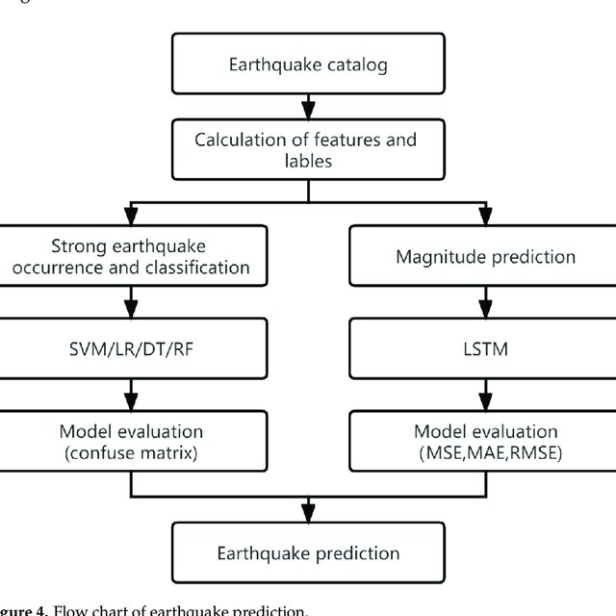
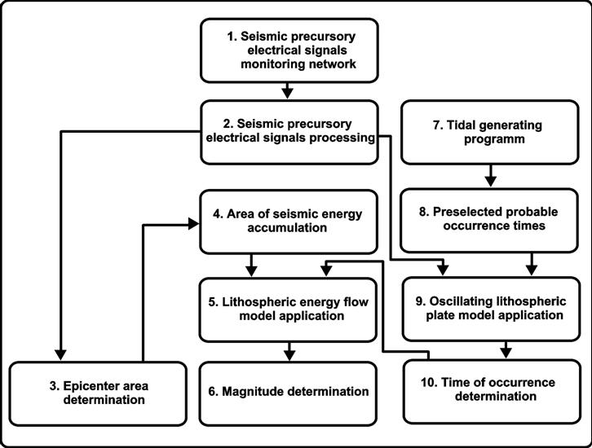
Modelling

Slide 11
RESULT
In result, our journey in developing an earthquake prediction model has been an illuminating exploration into the world of seismic data and machine learning. By meticulously cleaning and engineering the dataset, we laid a solid foundation for our analysis. Our feature exploration efforts revealed valuable insights into the characteristics of earthquakes, paving the way for informed modeling decisions (Sakaki, Okazaki and Matsuo, 2013). The creation of a global earthquake frequency map added a visual dimension to our project, highlighting regions prone to seismic activity. This visualization underscores the importance of predictive models in enhancing disaster preparedness and response. Our model development phase, where we constructed a neural network for earthquake magnitude prediction, showcased the power of machine learning in harnessing complex data for practical purposes. The model's impressive accuracy on the test set is a testament to its potential for real-world applications

Slide 12
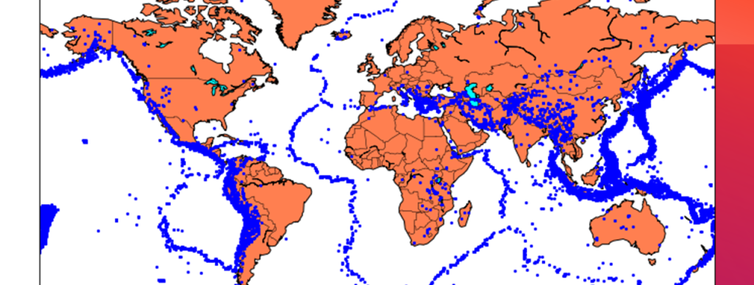
Earthquake Prone Areas

